Slide 1
Supervised mL - Final project https://github.com/laguila11/boulderMSDS/tree/main/ML-Cost-of-Living
U.S. Cost of Living based on Macroeconomics indicators

Slide 2
Supervised learning problem u.s. cost of living - macroeconomics
Purpose of this project is to build a Supervised Machine Learning model using the US macroeconomic data to predict the cost of living for US householders.
Target Variable is the total annual expenditure, which is published by the U.S. Bureau of Labor Statistics (BLS).
The macroeconomy data that will be considered in this model are :
1) Inflation rate : Annual consumer product index (CPI)
2) Employment / Unemployment statistics by the U.S. Census Bureau
3) Housing prices provided by the leading housing portal Zillow.

Slide 3
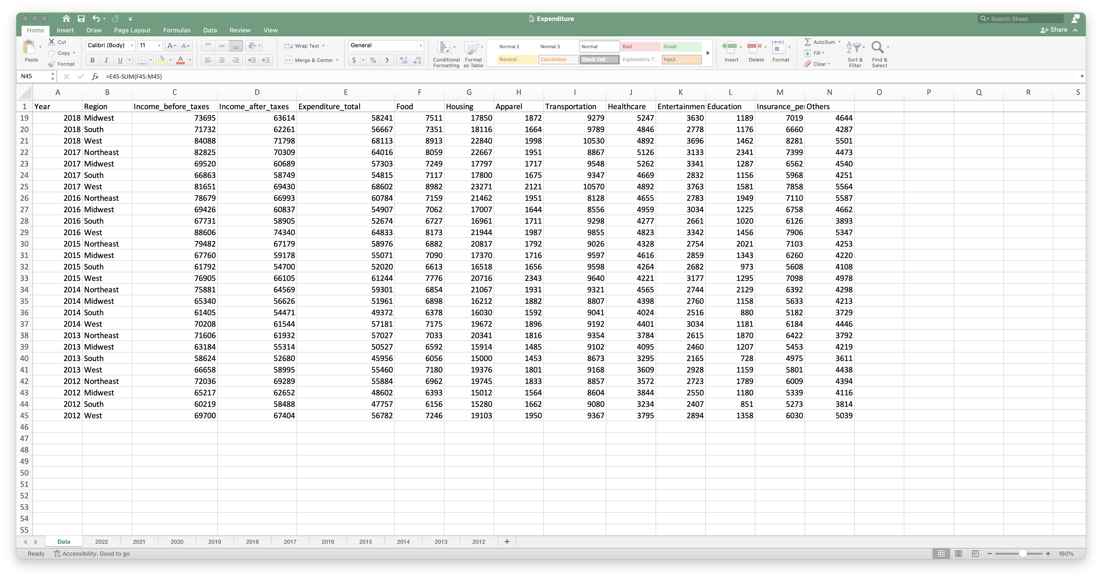
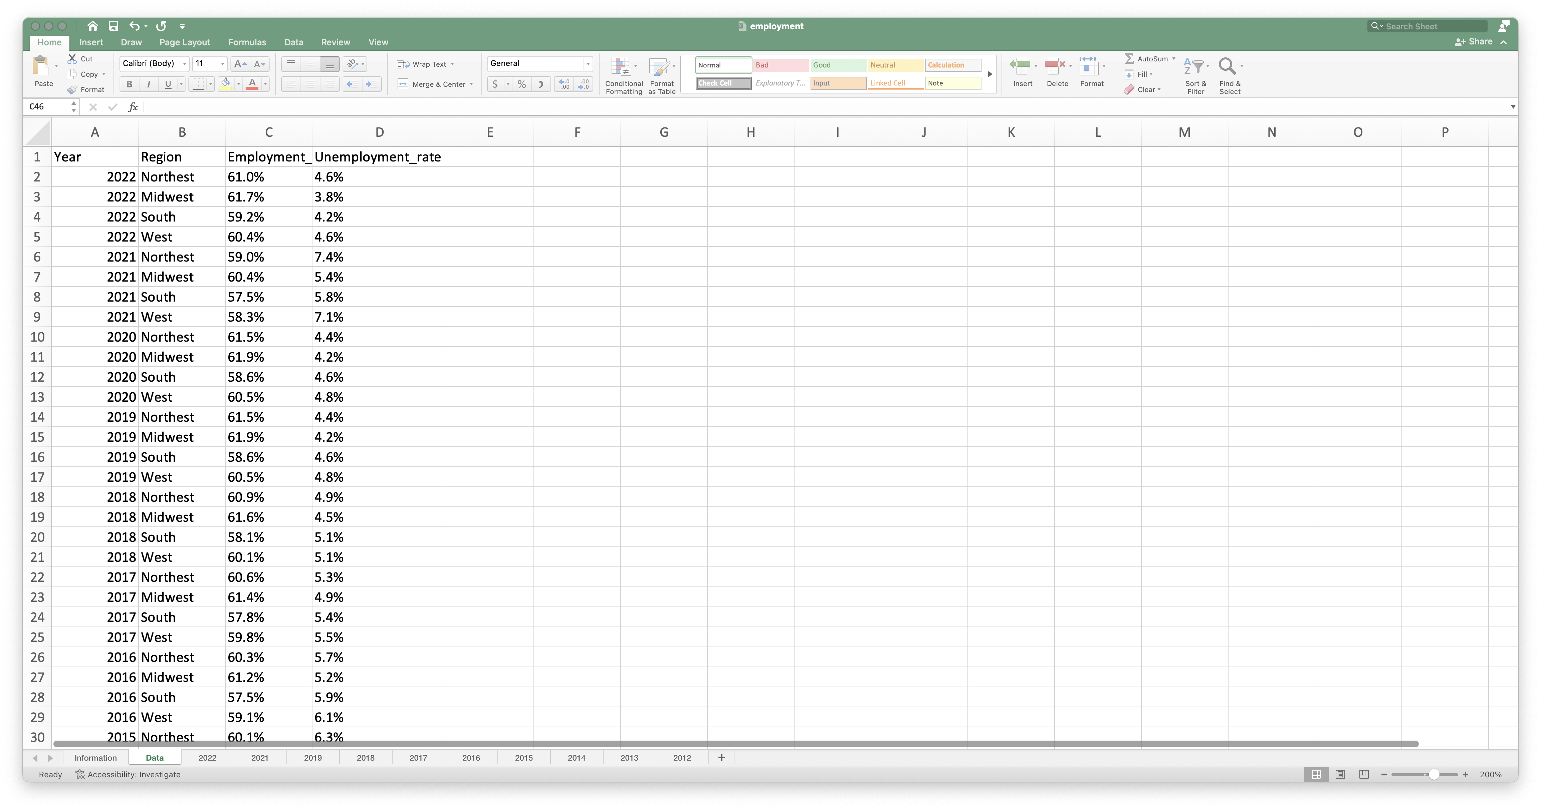
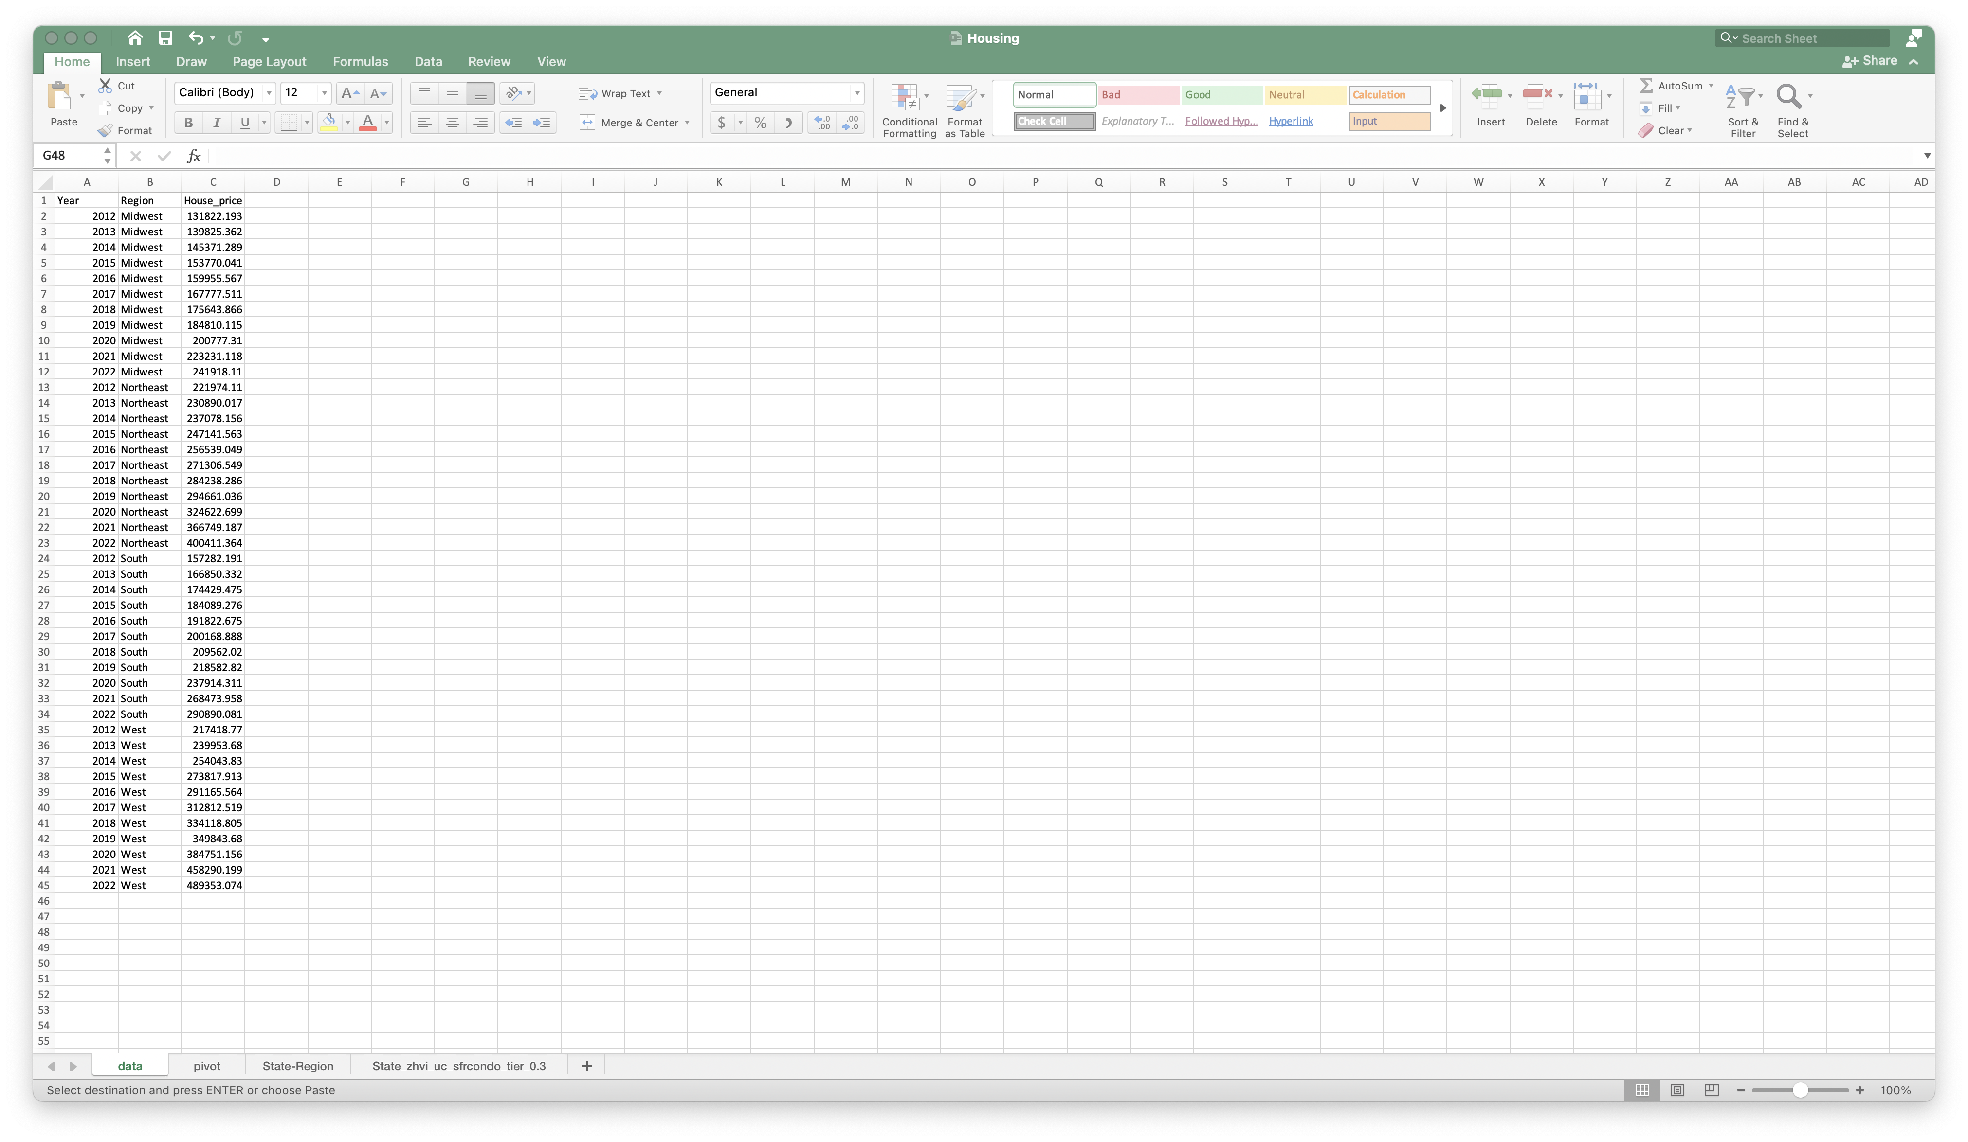
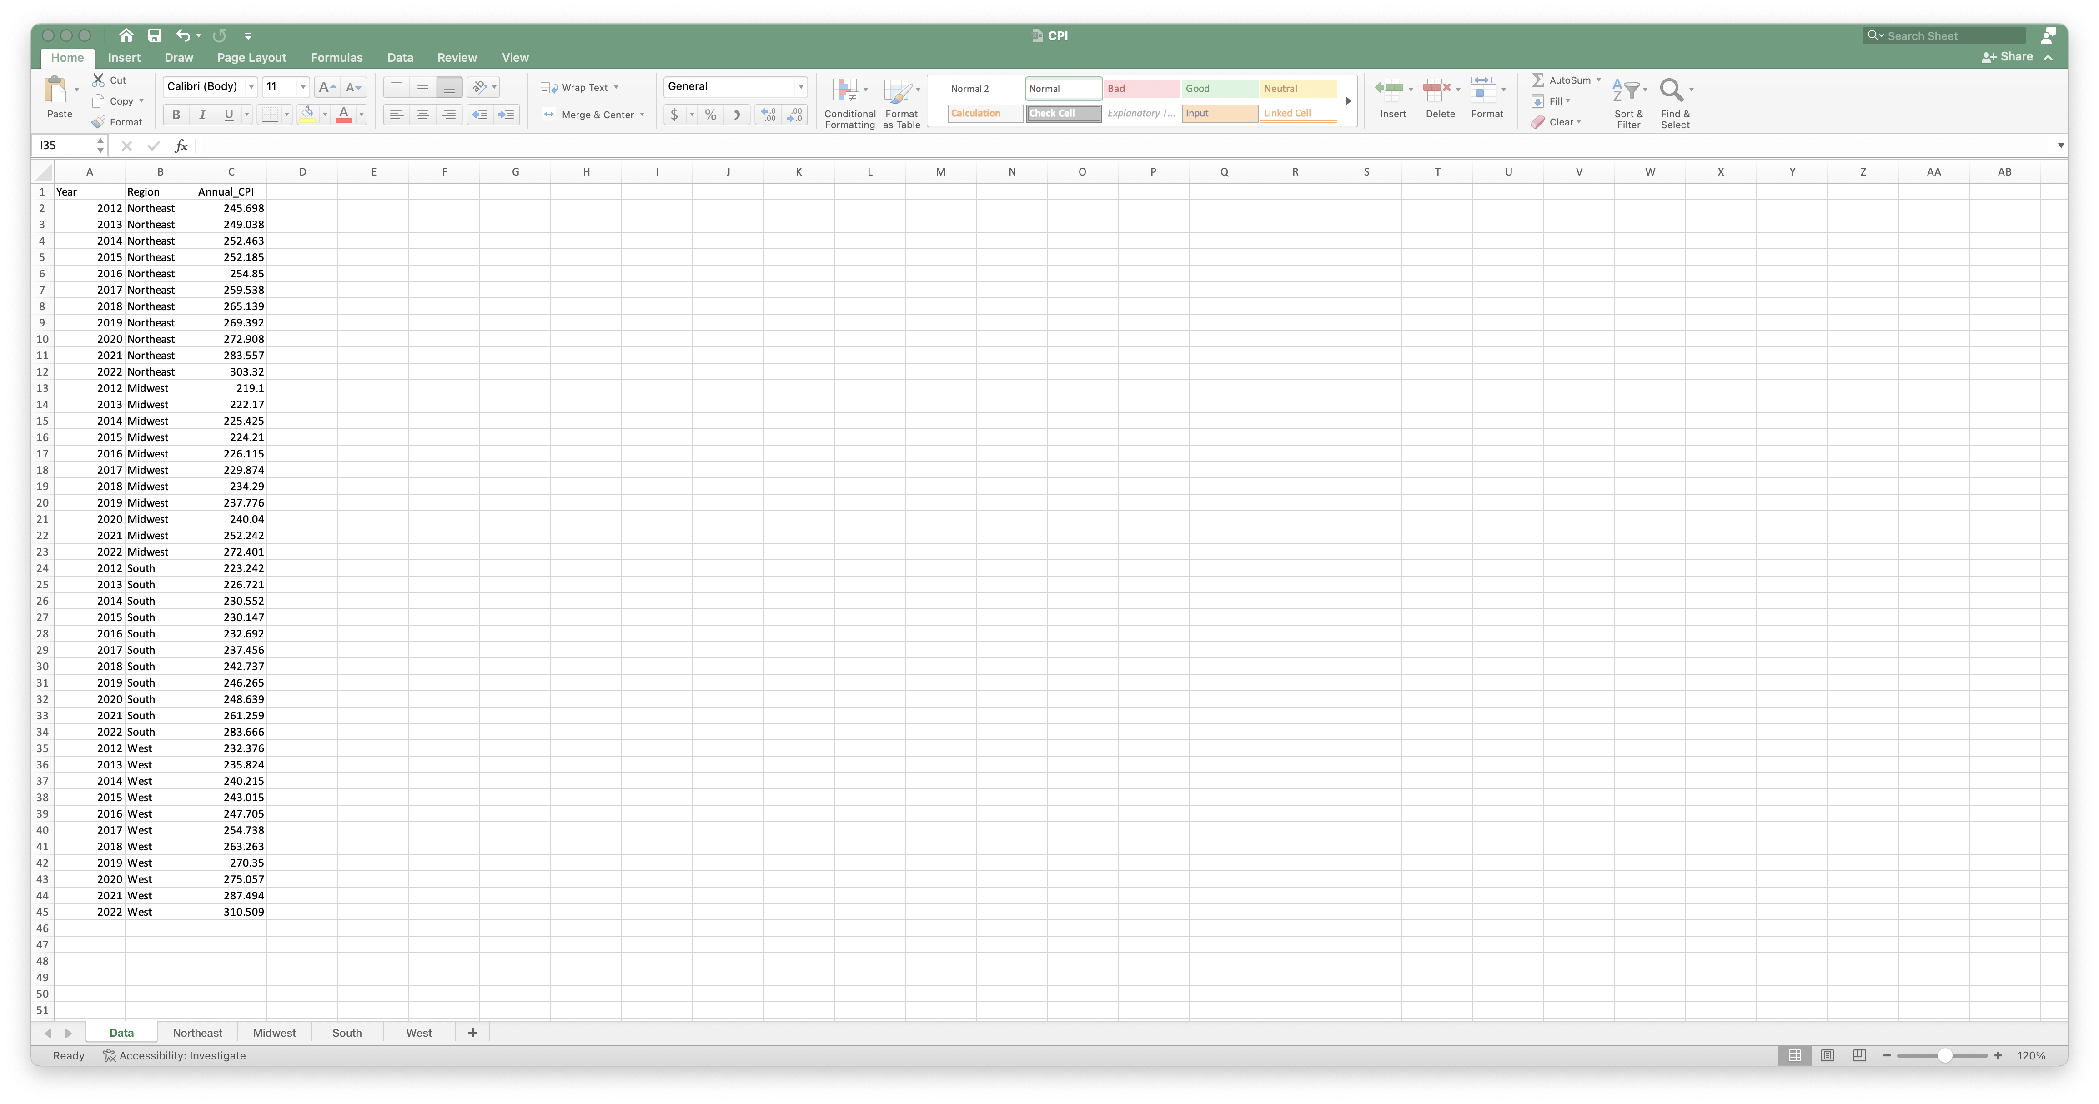
EDA – Data loading & cleaning
***U.S. Bureau of Labor Statistics :***
https://www.bls.gov/cex/tables.htm
1. All Urban Consumers - (Consumer Price Index - CPI)
2. Consumer Expenditure Survey (CE)
***U.S. Census Bureau :***
https://data.census.gov/
1. Employment rate by BLS region
***Zillow housing data:***
https://www.zillow.com/research/data/
1. Zillow Home Value Index (ZHVI) all homes by state

Slide 4
EDA – Data loading & cleaning
df_expenditure.info()
df_employment.info()
df_CPI.info()
<class 'pandas.core.frame.DataFrame'>
RangeIndex: 44 entries, 0 to 43
Data columns (total 14 columns):
# Column Non-Null Count Dtype
--- ------ -------------- -----
0 Year 44 non-null int64
1 Region 44 non-null object
2 Income_before_taxes 44 non-null int64
3 Income_after_taxes 44 non-null int64
4 Expenditure_total 44 non-null int64
5 Food 44 non-null int64
6 Housing 44 non-null int64
7 Apparel 44 non-null int64
8 Transportation 44 non-null int64
9 Healthcare 44 non-null int64
10 Entertainment 44 non-null int64
11 Education 44 non-null int64
12 Insurance_pensions 44 non-null int64
13 Others 44 non-null int64
dtypes: int64(13), object(1)
memory usage: 4.9+ KB
<class 'pandas.core.frame.DataFrame'>
RangeIndex: 44 entries, 0 to 43
Data columns (total 4 columns):
# Column Non-Null Count Dtype
--- ------ -------------- -----
0 Year 44 non-null int64
1 Region 44 non-null object
2 Employment_rate 44 non-null object
3 Unemployment_rate 44 non-null object
dtypes: int64(1), object(3)
memory usage: 1.5+ KB
<class 'pandas.core.frame.DataFrame'>
RangeIndex: 44 entries, 0 to 43
Data columns (total 3 columns):
# Column Non-Null Count Dtype
--- ------ -------------- -----
0 Year 44 non-null int64
1 Region 44 non-null object
2 Annual_CPI 44 non-null float64
dtypes: float64(1), int64(1), object(1)
memory usage: 1.2+ KB
df
# Since the rates are loaded as object, we need to convert these two attribute to numeric
df_housing.info()
<class 'pandas.core.frame.DataFrame'>
RangeIndex: 44 entries, 0 to 43
Data columns (total 3 columns):
# Column Non-Null Count Dtype
--- ------ -------------- -----
0 Year 44 non-null int64
1 Region 44 non-null object
2 House_price 44 non-null float64
dtypes: float64(1), int64(1), object(1)
memory usage: 1.2+ KB

Slide 5
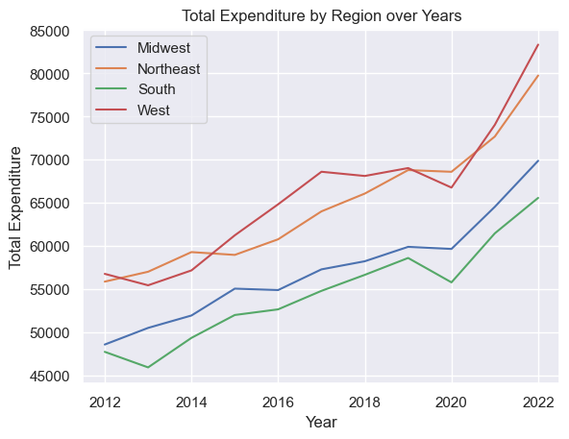
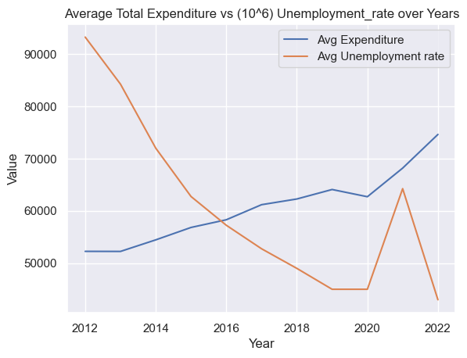
EDA - Visualization

Slide 6
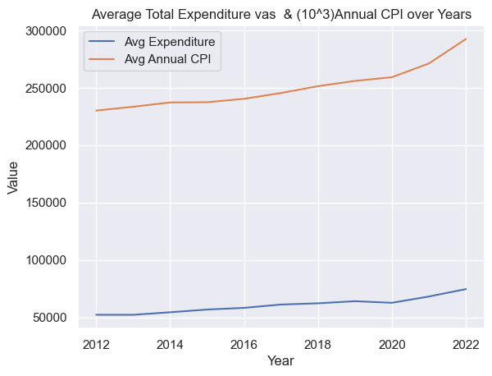
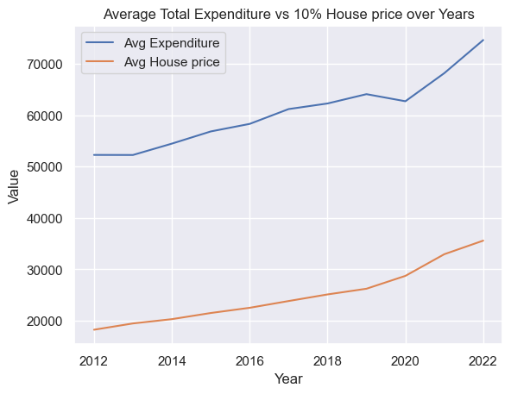
EDA - Visualization

Slide 7
Model building
Correlation Matrix
Data adaptation : convert Region (string) to numeric
Drop unnecessary features : ['Region','Food','Apparel','Others','Housing','Insurance_pensions','Education','Entertainment','Income_after_taxes’])
Sort data by Year and Region numeric
 | Year | Income_before_taxes | Expenditure_total | Transportation | Healthcare | Employment_rate | Unemployment_rate | Annual_CPI | House_price | Region_num
Year | 1.000000e+00 | 0.788233 | 0.766206 | 0.754656 | 0.913263 | 0.455044 | -0.796998 | 0.758988 | 0.619357 | -8.119262e-15
Income_before_taxes | 7.882331e-01 | 1.000000 | 0.959763 | 0.672039 | 0.751645 | 0.498494 | -0.529885 | 0.926128 | 0.866853 | -1.077857e-01
Expenditure_total | 7.662065e-01 | 0.959763 | 1.000000 | 0.758304 | 0.747309 | 0.470976 | -0.509381 | 0.935513 | 0.905532 | 1.311512e-02
Transportation | 7.546557e-01 | 0.672039 | 0.758304 | 1.000000 | 0.676912 | 0.202244 | -0.471205 | 0.749910 | 0.684320 | 3.139452e-01
Healthcare | 9.132629e-01 | 0.751645 | 0.747309 | 0.676912 | 1.000000 | 0.657441 | -0.808730 | 0.645862 | 0.486141 | -1.417233e-01
Employment_rate | 4.550436e-01 | 0.498494 | 0.470976 | 0.202244 | 0.657441 | 1.000000 | -0.671436 | 0.303436 | 0.164862 | -4.760350e-01
Unemployment_rate | -7.969976e-01 | -0.529885 | -0.509381 | -0.471205 | -0.808730 | -0.671436 | 1.000000 | -0.437008 | -0.282565 | 1.149371e-01
Annual_CPI | 7.589880e-01 | 0.926128 | 0.935513 | 0.749910 | 0.645862 | 0.303436 | -0.437008 | 1.000000 | 0.925865 | -2.926100e-02
House_price | 6.193570e-01 | 0.866853 | 0.905532 | 0.684320 | 0.486141 | 0.164862 | -0.282565 | 0.925865 | 1.000000 | 2.195661e-01
Region_num | -8.119262e-15 | -0.107786 | 0.013115 | 0.313945 | -0.141723 | -0.476035 | 0.114937 | -0.029261 | 0.219566 | 1.000000e+00

Slide 8
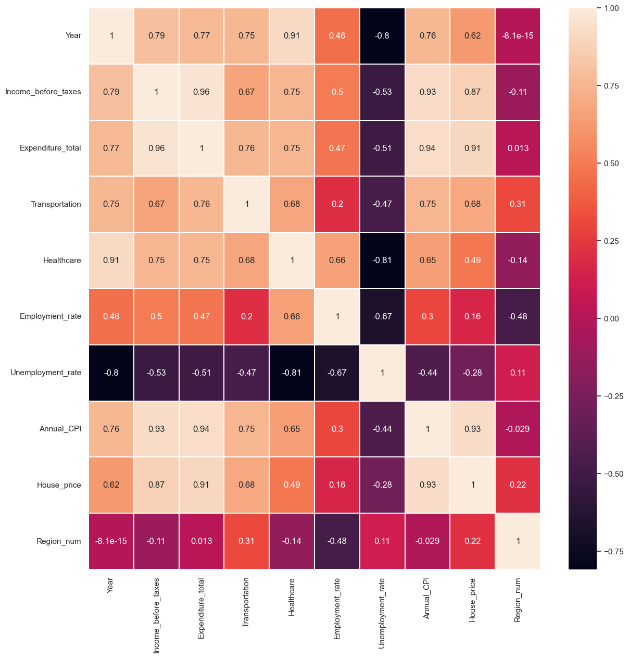
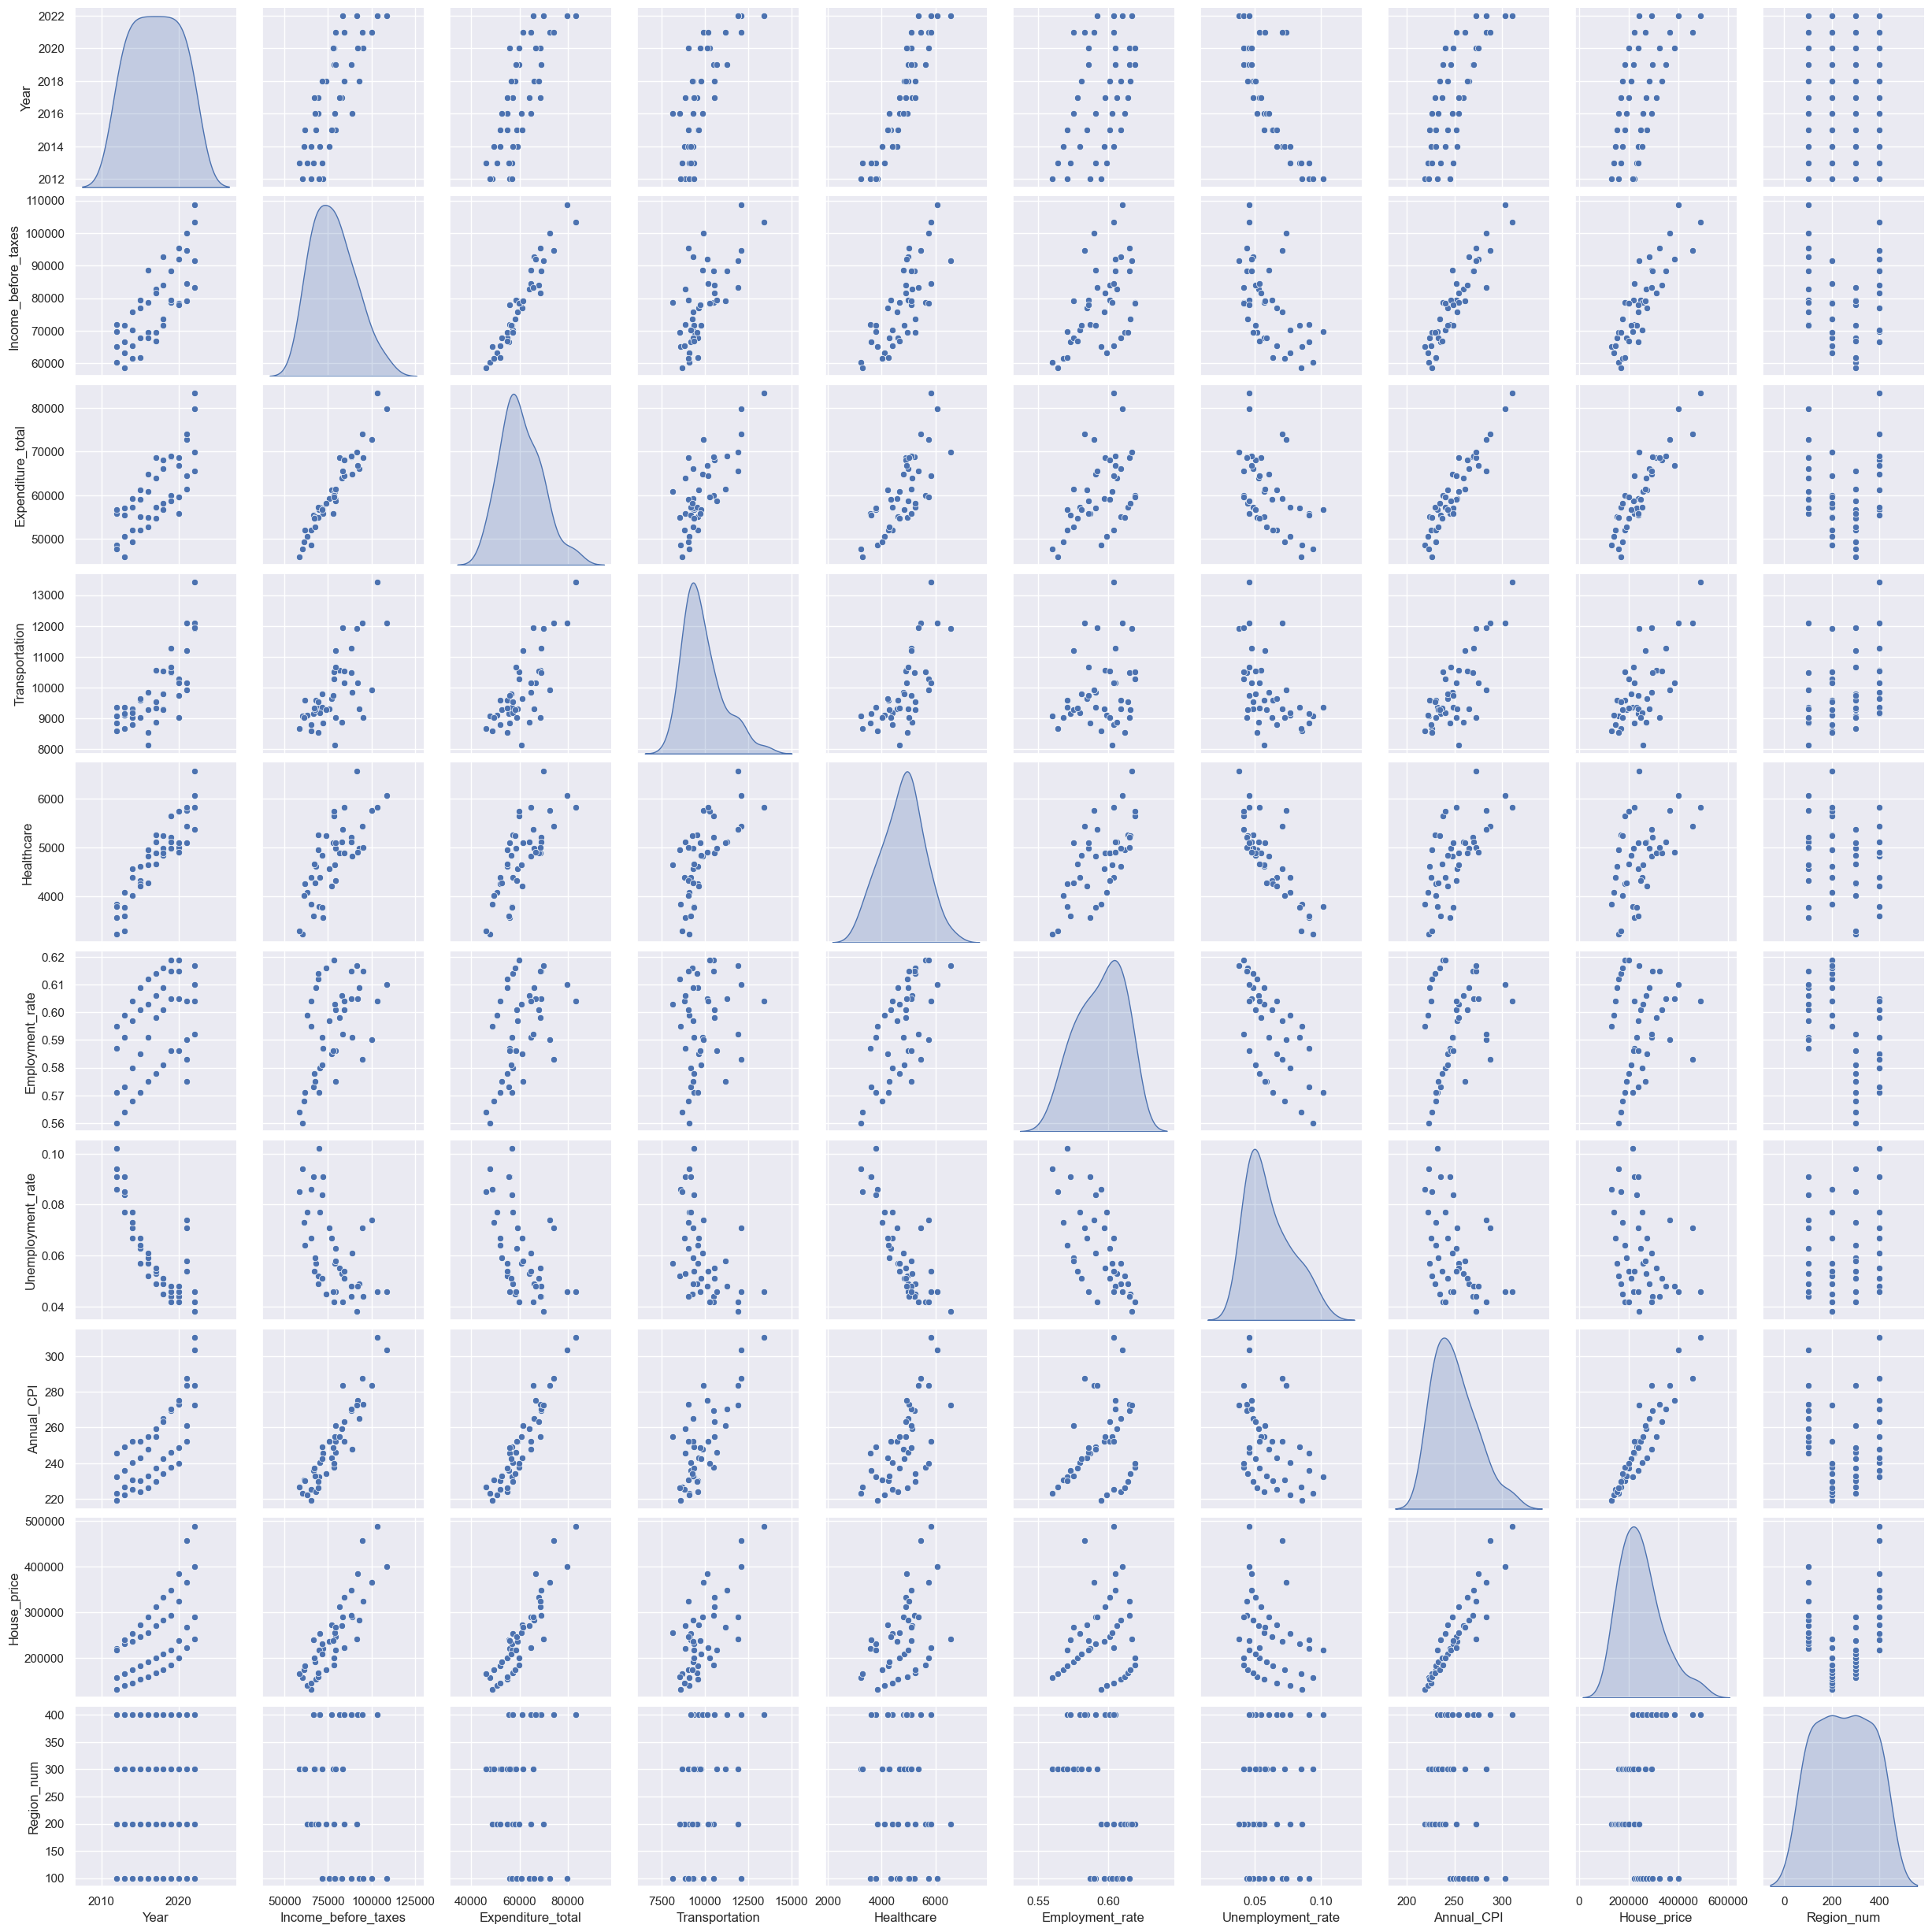
Model building
Correlation Matrix Heatmap
Pair Plot

Slide 9
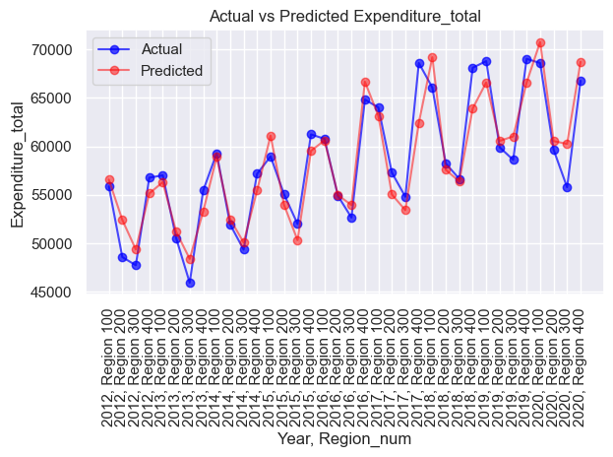
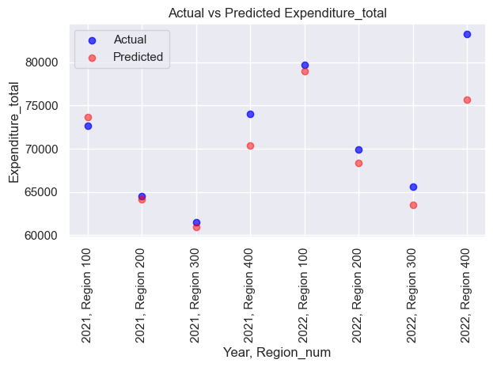
Simple linear regression
Best predictor : Income_before_taxes
Max R2 score : 0.8798355503489361
Train data : Year <= 2020
Test data : Year > 2020

Slide 10
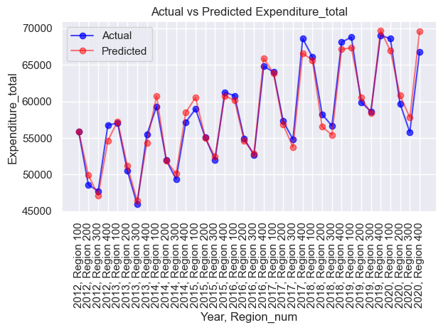
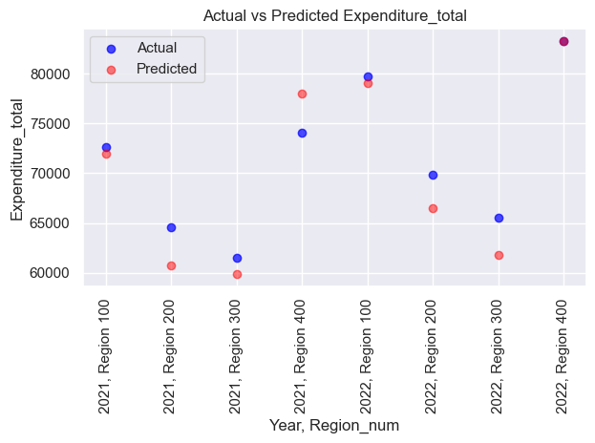
Multi linear regression
Mean Squared Error: 7440270.739206381
R-squared Score: 0.8519313745112188
Train data : Year <= 2020
Test data : Year > 2020

Slide 11
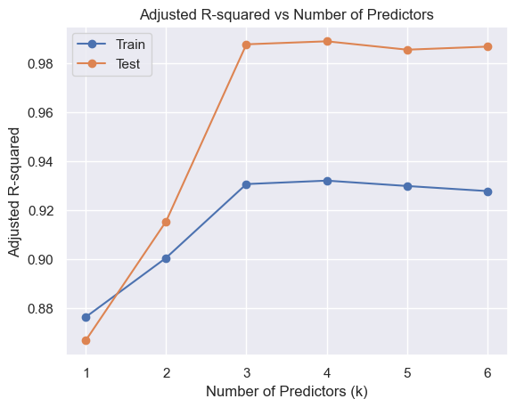
Forward stepwise refinement multi-predictor model
Best predictors and resulting r-squared adjusted
best: ['Income_before_taxes', 0.8798355503489361]
best: ['House_price', 0.9061379883738019]
best: ['Employment_rate', 0.9365174480827176]
4. best: ['Region_num', 0.9397437616537183]
5. best: ['Year', 0.9398059918720612]
6. best: ['Annual_CPI', 0.9400968830089957]

Slide 12
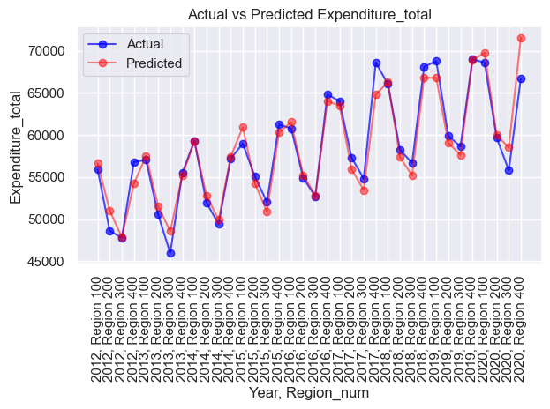
Multi predictor model
1-predictor model
R-squared: 0.880
Train data : Year <= 2020
3-predictor model
R-squared: 0.937
Train data : Year <= 2020

Slide 13
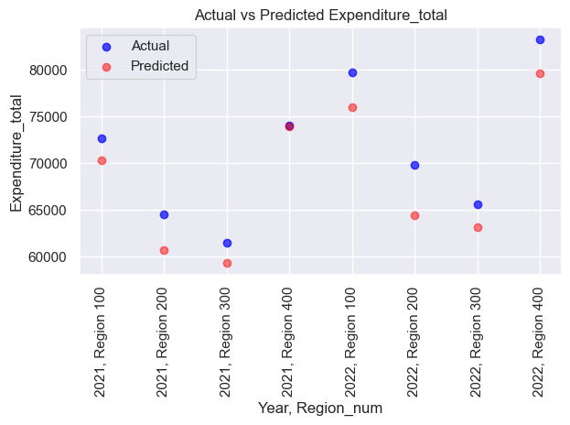
Multi predictor model
1-predictor model
R-squared: 0.880
Test data : Year > 2020
3-predictor model
R-squared: 0.937
Test data : Year > 2020

Slide 14
Multi predictor model
# data entered manually with assumptions in income before taxes.
# Employment rate, CPI and House_price are the year-to-date (Oct23) values.
data = {
'Year': [2023],
'Income_before_taxes': [85000],
'Expenditure_total': [0],
'Transportation': [0],
'Healthcare': [0],
'Employment_rate': [0.6125],
'Unemployment_rate': [0],
'Annual_CPI': [300],
'House_price': [296500],
'Region_num': [300]
}
1-predictor model
R-squared: 0.880
Predicted Expenditure for Region South in 2023 $64,476.80 This is a [-1.67622938] % variation
3-predictor model
R-squared: 0.937
Predicted Expenditure for Region South in 2023 $66,015.77 This is a [0.67063319] % variation

Slide 15
conclusions
Collected data from public sources to build a supervised learning model that can predict the evolution of the annual cost of living for U.S. Households based on the US macroeconomic indicators.
Annual total expenditure is the target variable. The features tested as predictors reflect the inflation (Annual CPI), unemployment (employment/unemployment rates) and housing prices.
Enough correlation between the target variable and the features coming from the macroeconomic indicators.
Visualization one anomaly the COVID pandemic years : 1) decrease of employment while expenditure remain almost 2) the house prices actually increased more than the trend in 2020-2021 3) after pandemic, the inflation (CPI) surged and we could clearly see that the index slope was much steeper than the expenditure in the years after 2020.
Simple linear model was with best predictor (Income_before_taxes) , R-squared score of 0.880 is already quite good. Multi-linear model gets a worse R-squared score of 0.850. better fit some outliers.
Used the forward stepwise refinement technique to come to the conclusion that the optimal model efficiency for the training and test data was achieved with a 3-predictor model.
Compared with the 1-predictor model, the 3-predictor model better fits and predicts the overall test data.
According to the optimal model the 2023 total expenditure in the South Region will be 66,015.77 ... To be check at the end of the year!
For further investigation, new data and could be used to enhance the models as well as other non-linear models.

Slide 16
END

